Slide 1
Planning the evaluation – Part 4 designing and administering surveys
Dr. Michelle Howard
Presenter’s Twitter Handle

Slide 2
Review: Main Components
Engage stakeholders
Describe the educational innovation/program
Choose evaluation framework
Gather credible evidence
Justify conclusions
Ensure use of evaluation findings
Notes:
For orientation, we are in the step of gathering credible evidence, specifically by designing good survey instruments to collect information about our program.

Slide 3

Learning objectives
At the completion of this module, you will be able to:
Articulate the steps in developing a survey instrument, or knowing what to look for when using a survey
Compare the pros and cons of different methods of survey administration
List the considerations in determining how many people to survey
Notes:
At the completion of this module, you will be able to:
Articulate the steps in developing a survey instrument, or knowing what to look for when using a survey
Compare the pros and cons of different methods of survey administration
List the considerations in determining how many people to survey

Slide 4
Outline
Notes:
In this module we’ll be closely following the paper by Rickards and colleagues, to learn about the process of creating good surveys. Data from surveys is central to many research and program evaluation projects, and conclusions are drawn from them. Whether we use an existing survey, or need to create our own, it is essential to use a well developed survey and to implement it with a view to achieving the highest response rate possible.
Before going further, I want to highlight the distinction between survey and questionnaire. Survey is a broad term that refers to a method of eliciting information. It could include questions asked in an interview or focus group. A questionnaire is typically a self-administered type of survey with specific questions and response structure. This module will use the term survey, but in the context of this course the material refers mainly to design of questionnaires.

Slide 5

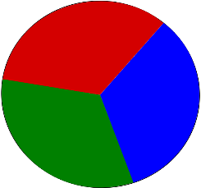
Survey Use in Evaluation of HSE
UBIQUITOUS e.g.
Evaluations of courses
Satisfaction with program
Perceived learning
CAUTIONS
Poorly designed survey leads to measurement error i.e.
Does not capture what is intended
Up to ¾ medical education research papers use a survey
Notes:
Some background for this module and why this topic is important in program evaluation.
The use of surveys in health sciences education research and evaluation is ubiquitous. There are estimates reported that up to three-quarters of medical education research uses a survey for at least part of the study design.
Surveys are used to measure abstract ideas or concepts that are difficult to quantify such as opinions, attitudes and beliefs. They are also useful for gathering information that is not easy to observe because they are generally easy to
implement with large numbers of people at little cost.
Examples of how you might use surveys in education program evaluation would be to elicit students’ experiences of a course or program, participant satisfaction with a program, or participants’ perceived learning.
Because they are so useful and relatively easy, it can be tempting to put together a few seemingly sensible questions about a topic, and use them to collect information in a study. However it is important to remember that just like other forms of measurement, things can go wrong if the instrument is not well designed and tested for its intended purpose. A poorly designed survey leads to measurement error. This means that it does not capture what it was intended to capture, or it does not elicit information reliably. So then an evaluator might be make invalid or faulty conclusions about a program. In order to produce credible evidence, several steps should be undertaken to ensure that a survey measure is fit for the purpose.

Slide 6
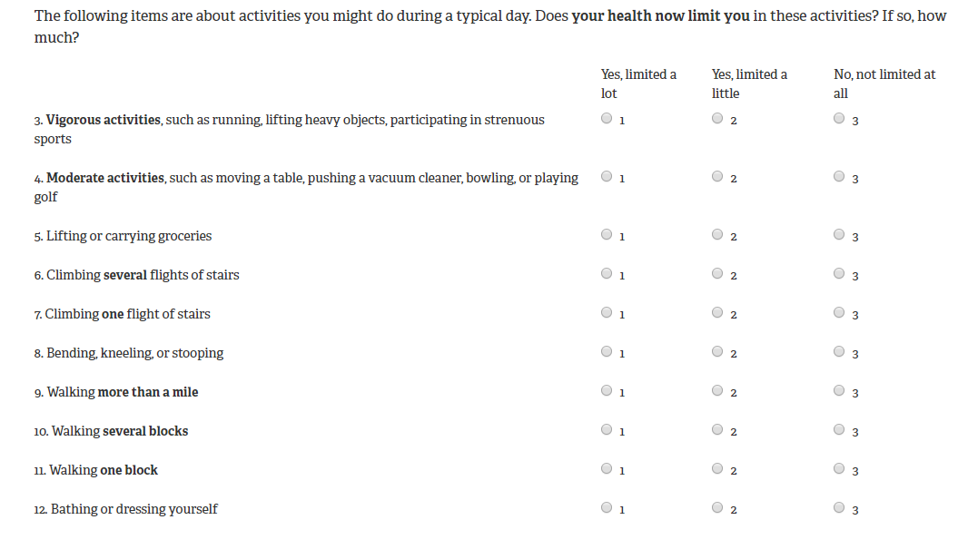
Survey Terminology
Construct = A hypothesized concept, model, idea or theory that is believed to exist but cannot be directly observed
Notes:
Before talking about how to create a good survey, or know what to look for if using an existing survey, there is some terminology to know.
Constructs are the central element around which surveys are designed. A construct is a hypothesized concept, model, idea or theory that is believed to exist but cannot be directly observed, or may be difficult to observe in a large number of people.
A famous example of a survey is the one designed in the Medical Outcomes Study (MOS) in the U.S. This study developed a survey to measure the construct of health-related quality of life. As you might imagine, this construct is difficult to observe, and is made up of many components. The components, in survey language, are called domains. This slide shows one of the domains of the survey reflecting functional ability. Within the domain of functional ability, there are several items. Looking at the items, it can be seen that they are conceptually related to each other, such as walking and climbing stairs. Related items in a survey make up a domain of a survey.

Slide 7
Survey Design and Use
Is a survey an appropriate tool?
How have others addressed this construct in the past?
How to develop survey items?
Are survey items clearly written and relevant to the construct of interest?
Will respondents interpret items in the manner intended?
Are the scores obtained reliable and do they relate to other measures as hypothesized?
Rickards G et al. You can’t fix by analysis what you’ve spoiled by design: Developing survey instruments and collecting validity evidence. J Grad Med Educ 2012;4:407-10.
Notes:
The next few slides will discuss issues of survey design, aligning to the main reading for this module by Rickards and colleagues. These questions provide a good roadmap for how to go about creating a survey.
The previous slide mentioned when to use a survey – and the answer is when you want to measure a concept that can be difficult to observe.
The next 2 questions relate to how to define the construct, and represent it through the survey questions. The important issue is that the right questions are asked, and that participants understand the questions as intended.
Finally there is a question about the responses from the survey, ensuring they are reliable and valid. There will be more discussion of these concept in upcoming slides.

Slide 8
Item Generation
Literature Review
Identify existing survey measures
If a new survey measure needed, to define the construct from previous research- how is it the same or different from other constructs? (e.g. depression versus anxiety)
Interviews or focus groups
People who represent population of interest
Experts on the topic
Notes:
Once it has been determined that a survey is needed, the first step is to review the literature to find existing survey measures that could be used with adaptation, or if a new survey is needed. If a new survey is needed, the goal of the literature review is to examine how others have defined the constructs from previous research. The other goal is to see how the construct of interest may be the same as or different from other related constructs. For example if one was creating a new measure to detect depression, it would be sensible to examine how anxiety has been defined as a construct in the literature to see how it is distinguished from depression, so that the depression measure is specific to that construct.
The next step that typically follows is to further define what the construct means, by studying relevant individuals, including both people who represent a population of interest, and experts on the topic. This can be done through interviews or focus groups to elicit how the construct is defined.

Slide 9
Item Generation Cont’d
Write out the items (i.e. questions)
Accurately reflect the construct
Use language of respondents
Start with more items and reduce
‘rule of thumb’- 25 questions to address a research question, approx. 5 per domain
Notes:
Once the survey developer has a working definition of the construct and what it includes and does not include, the survey items or questions are drafted. The interviews in the previous step help in order to use the language of the respondent population. It is recommended to start with more items to ensure everything is captured, then undertake a process of item reduction.
The general rule of thumb is to have a survey of no more than 25 questions, and this might mean approximately 5 per domain, but this varies according to how complex the construct is.

Slide 10
Item Reduction
Why?
To make as short as possible without losing necessary information (keeping desired constructs)
Eliminate questions that duplicate the same idea
Eliminate or re-word questions that are difficult to answer
Eliminate questions that everyone answers the same way
How?
Expert input
Pilot testing
Statistical analysis
Notes:
In terms of minimizing participant burden and maximizing the response rate, the shorter the survey the better, without sacrificing critical content. Item reduction can be done at several steps during the survey design process and does not need to be done only during the first draft phase. This step involves taking the list of potential items and reviewing them for duplication of the same idea, removal of items that may be difficult to understand, and eliminating questions that everyone answers the same way, thus not providing any information.
This can be done in the first draft by expert input, as a result of pilot testing with actual participants, and when enough data has been collected to conduct statistical analyses that show which items are redundant.

Slide 11

Testing the Survey
Pre-testing Pilot testing Clinical sensibility testing
Focus on Individual Items
Expert review
Language clarity, readability, cultural issues
Interpretation of individual questions
Focus on entire survey
Actual respondents
Penultimate draft of entire package (pre-amble, introductory letter etc)
Ensure consistent interpretation, accurate responding
Flow, ease, burden
May use for statistical testing of reliability and validity (n=100+)
Focus on big picture
Asks about whether the survey reflects the issue of interest - comprehensive, on topic
Notes:
Finally, you would show the draft survey to people, some of whom would represent your actual respondents. Pre-testing involves a small sample, perhaps 10-20 people for the purposes of checking language clarity, readability, suitability in the culture if relevant, and listening for how they interpret the questions. This stage is done typically in a face-to-face interview where the respondent is asked to discuss their interpretations of the questions.
After pre-testing, further modifications may be needed before pilot testing. Pilot testing is done with actual participants. The intent is to test the entire process including the pre-amble to the survey and any introductory materials, as well as the flow of the process. This step is typically done with more participants, and it gives a further sense of how respondents answer the questions. There will be enough data to see whether there are any problems with the interpretation of questions. Sometimes the survey developer will sample a large enough number of 100 or more, to use the data for reliability and validity checking with statistical methods. We’ll come to that in a minute.
Another concept from health survey literature is clinical sensibility. It relates to the idea of comprehensiveness of the survey in terms of reflecting the construct. By the time the survey is at this stage, experts and respondents should find that the questions cover the construct, there are no major missing domains or ideas. This idea can be addressed at different stages, including early on when generating items, and later when items are being removed, added or changed through pilot testing.
In reality, completing all of the steps of survey design can be challenging and take a long time, and often developers make adjustments that are sensible based on what they learn through the survey development process, or whether they are adapting an existing survey that has already tested language and comprehension. Sometimes all of these goals in this slide are met in a single phase of survey development working with topic experts and a sample of respondents.

Slide 12
Validity
Validity = the degree to which evidence and theory support a measure’s intended use
Not a ‘property’ of the survey - depends on context and population
Accumulation of evidence across time, settings, samples to build an argument
Face, content, construct, criterion
Notes:
We’ll turn here to the concepts of validity and reliability of surveys. A survey should have evidence of both, and the careful steps of survey development that we just reviewed are in service to establishing validity and reliability.
Validity is the degree to which evidence and theory support a measure’s intended use, or in other words, the survey measures what is intended. Note that validity is not a static property of a survey, but a concept for which we gather evidence as it is developed and used. The evidence for validity of a survey builds as it is tested and used in different settings and populations.
Validity is assessed throughout survey development. At the initial stage of item generation, face and content validity are checked to ensure the survey reflects the construct overall. Other types of validity are evaluated using data from respondents. Construct validity is examined by checking whether groups of questions in the survey correlate in predictable ways, for example a section on self-assessed knowledge might be expected to correlate positively with a section on confidence. Criterion validity is examined by checking how the new survey correlates to a gold standard. For example a self-reported health survey might be expected to correlate negatively with actual seeking of health care.

Slide 13

Reliability Types
Reliability = extent to which the scores produced by a the survey are consistent and reproducible
Test Re-test
To assess whether the same question posted to the same individuals gives consistent results at different times
Internal consistency
To assess whether different items in the same ‘construct’ are correlated with each other (versus items from other constructs)
Notes:
Reliability is the extent to which the scores produced by a the survey are consistent and reproducible. Reliability is necessary for validity, because if the survey was unreliable it cannot produce a measure of a construct. However reliability does not guarantee validity. A survey could perfectly measure the wrong construct.
There are 2 main types of reliability commonly established for a self-reported survey.
Test re-test reliability assesses whether the same question posted to the same individuals gives consistent results at different times
Internal consistency reliability assess whether different items in the same ‘construct’ are correlated with each other versus items from other constructs

Slide 14

Re-Cap
There are many steps to good survey design
Use existing survey where possible – look for elements of good design
Pilot test in your population
Allow time and resources if developing a new survey
Notes:
To re-cap
There are many steps to good survey design
Use existing survey where possible – and look for elements of good design
When using an existing survey, it is recommended to pilot test it in your population to make sure respondents interpret it as intended
And allow for the time and resources needed if developing a new survey

Slide 15
Methods of Administration
Self-administered – Paper based
Likely remains best option
Works for people who don’t use computer
More personal – send a pre-notice, reminders
Easier to track responses
Self-administered – Electronic/Online
OK for captive audience (e.g. recent graduates, course evaluation)
Inexpensive
Generally low response rate
Difficult to track respondents, more ‘incompletes’
Easy to ignore (survey overload)
More likely to complete if it comes from a respected source, relevant to respondent
Interviewer administered
Time intensive, expensive
Difficult to schedule
Interviewer effects
Use sparingly, as needed e.g. small target population, detailed survey
Notes:
Once the survey is ready, there are some considerations in how to have respondents complete it.
Most often, surveys are intended to be self-administered for reasons of cost. However there are different ways to do this.
Online surveys are very popular and can work well when you have an audience that is likely to be very engaged and already interacting with the program electronically. This is an inexpensive way to do a survey. But, online surveys are also easy to ignore or be missed if the invitation is sent by email due to people’s large volume of email traffic, and they generally yield a low response rate. Also, in a mass email, it can be difficult to personalize the invitation.
However people are more likely to complete it if the request comes from a respected source they know, and the topic is relevant to them.
Another self-administered option is paper based, either in person or by mail. Response rates tend to be higher than online surveys, you can reach people who do not use a computer regularly, and it allows for more personalization of the invitation, if done by mail. Best practices in survey administration also recommend if doing a mail survey, send a pre-notice letter that the survey is coming, and send at least one reminder and a new survey to non-respondents after a couple weeks. With a mail or in-person paper survey it is easier to track who has responded. In an online survey, unless you give respondents a unique link or login, it can be impossible to know who has responded or who has accessed the survey. With a paper survey people can stop part way through and finish later, with an online survey this may lead to confusion and incomplete responses.
Interviewers can also administer a survey directly with participants. This is more time intensive and expensive but sometimes necessary. This technique is usually best used for a small target population where the survey is detailed or where there is a high chance of not finishing the survey, for example with children or sicker individuals in hospital. Scheduling is another challenge, as people may be wary of phone-calls from strangers or it may be challenging to meet in person if the survey is being done outside a routine encounter.

Slide 16
Achieving good response rate
A good response rate is 70% for generalizability
Lower than 50% is questionable
Improving response rate:
Pre-notice
Shorter survey
Reminders (up to 2 after initial)
Incentives (pre-completion)
Notes:
Achieving a good response rate will be particularly important in program evaluation, because any given program may not have a large number of participants, and all responses will be important.
Generally, a good response rate is 70% or higher, and lower than 50% may be questionable in terms of representing the population of interest.
The literature shows that there are several ways to improve response rate:
Give participants advance notice the survey is coming and when – this is called a pre-notice
Shorter surveys are more likely to be completed
Send up to 2 reminders to non-respondents
If possible, provide a small incentive at the time survey completion is requested. It does not need to be a large amount, giving a toonie in the envelope has been shown to be effective. Give this to everyone to thank them, even if you don’t know if they will respond. Offering to send compensation after completion is not as effective.

Slide 17
What is the right sample size?
Some ‘rules of thumb’
Surveying ALL or SOME program participants?
Survey ALL if possible (e.g. if 100 or fewer)
Survey a sample of SOME if all not possible
If using a sample – confidence in estimate
A common standard is 95% confidence, with a sampling error of +/- 5%
Allow for non-response – inflate sample size
Expect at least 20% non-response
Diminishing returns (5% margin of error)
Need to sample:
80 from population of 100
278 from population of 1000
370 from population of 10,000
http://www.evaluativethinking.org/docs/SEC_Session2/Samplesize.pdf
Notes:
The final concept I would like to cover is sample size. We won’t go into detail of statistical calculations here, just some general rules of thumb.
The concept of sample size relates to the idea that in research, we usually can’t study an entire population, so we must select a representative sample. Recall back to an earlier module that in research the goal is to produce new generalizable knowledge. In program evaluation, we want to know the thoughts of the specific program participants and we want to be as certain as possible about the accuracy of what we learn. So if the number of participants is not too large and resources allow surveying everyone, this should generally be done. For example if the program includes 100 participants it would be reasonable to survey everyone. If there were 1000 participants it may not be reasonable, and you would need to consider a sample size calculation. This is point number 1 on this slide.
Point number 2 is about drawing an inference from a sample of all potential participants. When we measure something in a sample, we must provide a level of confidence in the estimate. An estimate could be the proportion of students who performed a skill adequately for example. A common standard for survey confidence is 95%, with a sampling error of plus or minus 5%. This means we believe that 95 percent of the time the results from the sample would be off by no more than 5% as compared to the results we would have seen if we had collected data from everyone. There are many easy to use online calculators for estimating a sample size needed from a given population size. Keep in mind the general concept shown here in the box. A sample from a very large population does not need to be extremely large to provide confidence. Also note that when sampling from a small population such as 100, you need to sample almost everyone to have confidence in the estimate.
The final point, number 3, relates to finalizing the sample size decision. Once the sample size is known, we need to account for the inevitable non-responses. Depending on the program and participants and considering the other issues described in this module about survey administration methods, the sample size should be inflated 20% at least, and perhaps 30% to 40%.

Slide 18
Methods of survey administration affect response rate
In many program evaluations it is reasonable to survey everyone rather than a sample
If a sample must be drawn, do a sample size calculation so the confidence in the estimate is known
Inflate the sample size to account for non-response

